Slide 1
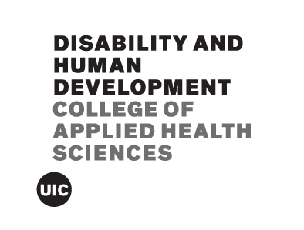
Screening for Current and Prospective Social Impairment Among Youth in the Child Welfare System: Consideration of Learning Profile Differences
Hena Thakur, MS, Amy Cohen, PhD & Joseph Cohen, PhD
Department of Psychology, Clinical-Community, University of Illinois at Urbana-Champaign
Introduction
Method
Results
Social Impairment
Social impairment is associated with psychological distress.
Individuals with disabilities are more likely to present with social impairment.
Screening for current and prospective risk of social impairment can help inform assessment and treatment of psychological distress among individuals with disabilities.
Learning Disabilities
Learning profiles can impact others’ perceptions of a youth’s social impairment.
Understanding the moderating effect of learning disabilities on reporting of social impairment can inform screening across disability populations (ADHD, autism).
The National Survey of Child and Adolescent Well-Being-II (NSCAW-II) is a longitudinal study that aims to investigate the well-being, service needs and service utilization of children who are involved with the child welfare system.
Present study involved a subsample of adolescents (N=884) who were 12-17 years old (Age_{M}=14.7).
Questionnaires by informant:
Baseline
-Youth self-report of internalizing (YSR INT) and externalizing symptoms (YSR EXT)
-Parent report of youth’s internalizing (CBCL INT) and externalizing symptoms (CBCL EXT)
-Teacher report of youth’s social skills (Current)
18-month follow-up
-Teacher report of youth’s social skills (Future)
Learning profiles (LP) were captured via discrepancies (>15 points) in verbal and nonverbal IQ standard scores:
1. Verbal dominant
2. Nonverbal dominant
3. Equal dominance
Current Social Impairment
Higher for those with verbal dominant learning profiles who self-reported greater internalizing symptoms.
Lower for those with nonverbal dominant learning profiles who self-reported greater internalizing symptoms.
Higher for those with greater parent-reported externalizing symptoms, especially those with fewer parent-reported internalizing symptoms.
Prospective Social Impairment
Higher for those with fewer parent-reported internalizing symptoms who self-reported greater internalizing symptoms.
Higher for those with greater parent-reported externalizing symptoms.
Higher for those with greater teacher-reported current social impairment.
Social Impairment Predictors: ASEBA
Achenbach System of Empirically Based Assessment (ASEBA) is the most widely used protocol for mental and behavioral health screening in the child welfare system.
Strengths of ASEBA
-Multi-informant (parent and youth)
-Multi-symptom (internalizing and externalizing)
Tables and Figure
Conclusions
Living Conditions
Biological or Adoptive Parent | 65.7%
Kin | 14.1%
Foster Care or Residential Program | 19.1%
Out of Home Arrangement/Unknown | 1.1%
Multi-informant and multi-symptom assessments are necessary for assessment of current and prospective social impairment.
Although not valid above and beyond the interaction between parent-reported internalizing and externalizing symptoms for current social impairment, learning profile differences may be informative for predicting certain aspects of social impairment.
Data Analytic Plan
Univariate regression analyses for assessment of Achenbach subscale validity for current and prospective social impairment.
Two- and three-way interaction regression analyses for assessment of:
-Cross-informant, and/or
-Cross-symptom, and/or
-Learning profile impact
Racial/Ethnic Identities
White | 51.2%
Black | 28.1%
Asian/Hawaiian/Pacific Islander | 4.6%
American Indian | 12.7%
Refused/Unknown | 3.4%
Acknowledgements
This work was supported by the Illinois LEND Program [Grant Number: T73MC11047; U.S. Department of Health and Human Services—Health Resources and Services Administration (HRSA)].

