Slide 1
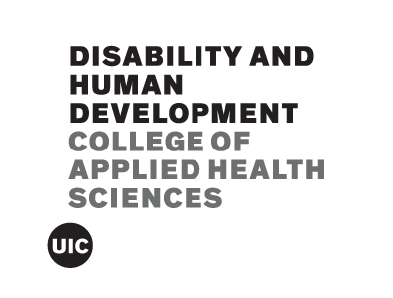
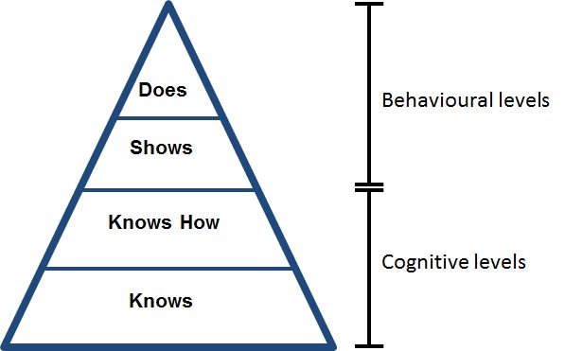
Piloting a Disability Curriculum for Undergraduate Pre-Health Affiliated Students
Zoie Sheets, MPH (c)
University of Illinois at Chicago
Background
Honors 201: Cripping Medical Culture
Conclusion
Disability in Society
Weeks 1-4
Disability and Healthcare
Weeks 5-11
Putting into Practice
Weeks 12-15
People with disabilities face a variety of barriers to accessing healthcare, including the attitudes of physicians themselves.¹ Part of this is due to the fact that physicians in the United States receive little to no training in how to care for people with disabilities (PWD).² A survey including 388 health profession students (predominantly physicians) found that an overwhelming majority had “negative attitudes about disability.”³ Healthy People 2020 lists “disability and health training for healthcare professionals,” as a top priority for this decade.¹
Medical schools have faced time and financial barriers when they have attempted to introduce disability curriculum. According to Miller's pyramid, one reason for this is that students are not prepared for this type of information because they lack foundational knowledge.⁴
Introducing undergraduate pre-health affiliated students to foundational disability concepts, and how these concepts relate to their specific field, allows students to complete the “knows” level of Miller’s pyramid before beginning professional school. The goal of this project was to develop and pilot an introductory curriculum for undergraduate, pre-health affiliated students on the topics of health and disability. Qualitative data was collected both through anonymous student feedback forms and students’ weekly reflection assignments.
Students in this course have consistently reported a deeper understanding of disability identity and the ways disabled people interact with healthcare systems, including barriers facing this population. Additionally, students have shown a high level of engagement and nearly perfect attendance, with only two (2) students turning in an assignment late. In their mandatory weekly reflection paragraphs, students have gone far below the surface level, asking deep questions and critically considering how to apply course concepts to their field. From student feedback, 3 main adaptations will be made for next semester:
1.Inviting in more guest speakers, including more people with disabilities
2. Using varied methods of instructions, including more videos and collaborative activities
3. Being more intentional in discussing non-physician experiences
Overall, the response to this class and the demonstrated understanding of disability concepts makes it clear that beginning these conversations in an undergraduate curriculum is a needed first step to creating a more disability-aware healthcare work force.
1: Introduction to Cripping
2: Gaining Shared Language
3: Models of Disability
4: Disability Culture
5: Medical vs. Disability Culture
6: Medical Industrial Complex
7: Guest Lecture from Physician Specializing in Disability and Ethics
8: Social Determinants of Health
9: Eugenics + Disability
10: Panel of Disabled Individuals
11: Disabled Doctors
12-14: Workshopping
15: Final Presentations
Student Reflections + Student Feedback
1. “It is common to view disabilities as limiting and constraining but there is a culture that should be celebrated and is often ignored.”
2. “Although it’s hard to change something that has been there for a long time, we can change it slowly by educating the new generations of medical workers in what is acceptable nowadays to fit our modern society.”
3. “I would like to learn more about disability studies, including more about what kinds of classes are offered at UIC regarding the better understanding of disability studies after reading this article because this article helped me realize how limited my understanding of disability really was.”
4. “Change can’t occur by people who don’t have any experience with it, laws can be passed and barriers can be broken only when we allow people with disabilities to be heard and let us know as a society what we’re doing wrong so we can collectively do a better job at being better people."
1. “Before coming into this class, I didn’t know much about the disability culture at all, & I think this class did a phenomenal job in helping students like me who’ve had little to no knowledge of the culture really grasp the concepts such as models & laws put in place for disabled people.”
2. “This course helped me understand the general idea of healthcare in the US. Honestly, I hardly knew anything about it before because I didn’t live here most of my life. Thus, I was shocked by stuff I learned such as the models of disability & how disability is considered a medical condition that needs to be treated. Also, I learned how medical workers treat & view disability. “
3. “Prior to taking this class, I had never seen or thought about the misconceptions about disability, but now I am able to see how major the issues regarding misconception about disability really are."
References
Koh, H. K., Blakey, C. R., & Roper, A. Y. (2014). Healthy People 2020: A Report Card on the Health of the Nation. JAMA, 311(24), 2475.
Symons, A. B., McGuigan, D., & Akl, E. A. (2009). A curriculum to teach medical students to care for people with disabilities: development and initial implementation. BMC Medical Education, 9(1).
Lam, W., Gunukula, S. K., McGuigan, D., et al (2010). Validated instruments used to measure attitudes of healthcare students and professionals towards patients with physical disability: a systematic review. Journal of NeuroEngineering and Rehabilitation, 7(1), 55.
Miller, G. E. (1990). The assessment of clinical skills/ competence/ performance. Academic medicine, 65(9), S63-7.
Miller’s Pyramid⁴
Acknowledgements
This work was supported by the Illinois LEND Program [Grant Number: T73MC11047; U.S. Department of Health and Human Services—Health Resources and Services Administration (HRSA)]. Thank you to Alyson Patsavas for continued mentorship and the UIC Honors College for ensuring this course was able to be offered to students.

