Slide 1
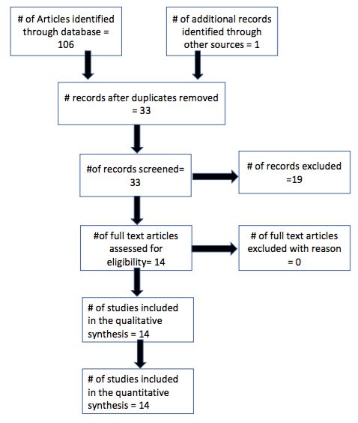
[Name]
[University]
Wandering and Elopement in Children with Autism Spectrum Disorder
A Systematic Review
Tanuja Kothinti, Penny Hartwell, Feifei Chen
Background
Results
Awareness Strategies
Wandering and elopement (i.e. leaving supervision without permission and running away from safe spaces) occur frequently in children with Autism spectrum disorder(ASD).
These behaviors pose a great risk for morbidity and mortality to children with ASD and is a major concern for their parents.²
There is a need for evidence-based practice in the treatment of elopement in individuals with ASD.
The systematic review yielded 14 studies, which provided intervention to a total of 33 participants.
Sample size of 1-9 participants
12 studies included only 3 participants or less.
Each of the study had at least one participant with a diagnosis of ASD.
Age range of 3-29 years old
The most common interventions and components of interventions among the studies included were: functional communication training, differential reinforcement, extinction, response blocking, and token economy.
Physical barriers were the most commonly used interventions by parents.
Overall, 71.4% of the studies reported positive outcomes and 28.5% reported mixed outcomes. No studies reported negative outcomes.
Translate the Advocate IL Masonic website page, “Autism, Wandering and Elopement” into Telugu, Gujarati, Chinese, and Polish languages.
Provide families with National Autism Association’s Big Red Safety Box
Help families apply for a disability placard
Aims
www.cyberdriveillinois.com
National Autism Association's Big Red Safety Box
Our aim was to conduct a systematic review to answer the following questions:
What is known about elopement and wandering behaviors in individuals with ASD?
What are the effective intervention strategies for elopement and wandering?
References
American Psychiatric Association. Diagnostic and statistical manual of mental disorders. 5th ed. Arlington, VA: American Psychiatric Association; 2013.
McLaughlin L, Keim SA, Adesman A. Wandering by Children with Autism Spectrum Disorder: Key Clinical Factors and the Role of Schools and Pediatricians, J Dev Behav Pediatr. 2018 Sep;39(7):538–546.
Anderson C, Law K, Daniels A, et al. Occurrence and family impact of elopement in children with autism spectrum disorders. Pediatrics. 2012 November; 130(5): 870–877.
McIlwain L, Fournier W. Mortality & Risk In ASD Wandering/Elopement 2011-2016 National Autism Association. MARCH 2017.
Nathan A Call et al. Clinical outcomes of behavioral treatments for elopement in individuals with autism spectrum disorder and other developmental disabilities. Autism 2017, Vol. 21(3) 375–379.
Boyle MA, Adamson RM. Systematic Review of Functional Analysis and Treatment of Elopement (2000–2015). Behav Analysis Practice (2017) 10:375–385.
Lang R et al. Treatment of elopement in individuals with developmental disabilities: A systematic review. Research in Developmental Disabilities 30(2009) 670–681.
Autism, Wandering and Elopement. Advocate Illinois Masonic website in English and Spanish. https://www.advocatechildrenshospital.com/care-and-treatment/injury-prevention/autism-wandering-elopement/https://www.advocatechildrenshospital.com/care-and-treatment/injury-prevention/autism-wandering-elopement/autism-wandering-spanish-version. Accessed April25, 2019.
Method
This systematic literature review was guided by Preferred Reporting Items for Systematic Review and Meta-Analysis (PRISMA) guidelines.
Searched PubMed, PsycINFO, Scopus and manual searches of journals to locate articles written in English and published in peer-reviewed journals
Inclusion criteria:
A research that had an intervention or strategy for elopement
At least one participant with ASD
Conclusion and Further Steps
Acknowledgements
The reviewed literature suggest that elopement may be reduced by function-based interventions. However, due to lack of experimental design and limited participants in the studies, the reports must be interpreted with caution.
Future research is needed to establish the effectiveness of functional analysis and function-based interventions.
Increase awareness with clinicians and families by sharing available resources in the state of Illinois and increasing cultural accessibility to local reliable online websites.
This work was supported by the Illinois LEND Program [Grant Number: T73MC11047; U.S. Department of Health and Human Services—Health Resources and Services Administration (HRSA)].
We would like to acknowledge the following individuals and groups without whom this research would not be possible:
Advocate Children’s Hospital, the Pediatric Developmental Center at Illinois Masonic Medical Center; University of Chicago, Comer Children’s Hospital, University of Illinois at Chicago Disability and Human Development; Dr. Sarah Bauer; Dr. Sarah Sobotka; Alix McNul; Dr. Kruti Acharya; Dr. Ann Cutler; Dr. Michael Msall.

