Slide 1
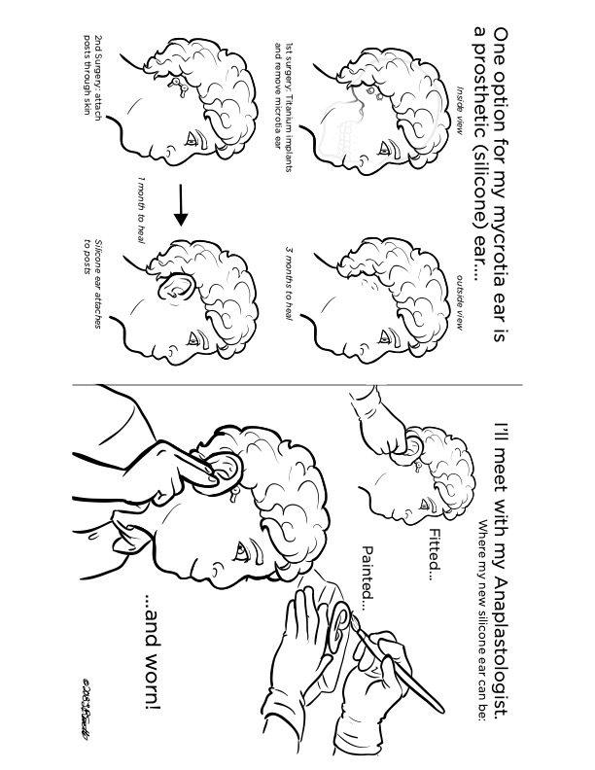
Developing Life Enhancing Resources for Patients with Craniofacial Conditions
Vanessa Aguilera, M.A. and Ikram Hassan, M.A.
Research Questions
Rationale for these Resources
Interdisciplinary Collaboration and Dissemination
What research has been done to evaluate and develop resources for craniofacial patients with complex medical conditions that have resulted in a disability?
What types of resources (e.g videos, pamphlets, books, etc.) are commonly recommended to this population?
What aspects of the aforementioned resources are reported to be helpful?
How could these resources be further improved/made more accessible?
Patients with medical conditions who require surgery benefit from use of patient education materials
  Reduces worry
  Feels inclusion in process
  Feels empowerment
Researchers in the field posit that use of patient education materials, such as a medical coloring book or brochure will help reduce psychosocial symptoms (e.g. shame and fear of ridicule)
Additionally, this modality of education decreases linguistic barriers to understanding surgical process
  E.g. Targets barriers like varying levels of medical literacy and receiving medical information in non- dominant language
Strong support for other medical conditions, but minimal use in craniofacial population
Multidisciplinary team at UI Health Craniofacial Clinic (UI Health CFC) develops the resources at the clinic
  Team: Medical providers, mental health providers and medical illustrators
Resource are shared with a diverse population of patients at UI CFC
  50% of patients identify as Latin-x, 15% identify as African American, 3% Asian, 30% Caucasian, and 2% Other
  70% of patients receive some sort of public aid (insurance)
  70% endorse being part of an ethnic minority group
Developing the Illustrative Resources
A Look on Communication and Culture
Decreasing Barriers
Research was provided to medical illustrators about HFM, including the process of surgeries, treatments, and role of each multidisciplinary team member
Drafts back and forth between illustrators and other members of treatment team occurred
  The goal was to focus on the illustrations first, then add labels/wording
  A child coloring book version and a parent pamphlet version were created
  Finally, to then translate the text into Spanish
People from culturally and linguistically diverse (CLD) backgrounds experience inequity and barriers in accessing AAC systems, supports, and services compared with their mainstream peers.Ethnic, racial, and linguistic minority students with disabilities are underrepresented in special education programs where AAC services are provided.
Language and Culture
80% of new immigrants who arrive in the United States speak a language other than English at home. Assessments should be modified to take into consideration cultural backgrounds and gather cultural and linguistically relevant data. Based on models that are integrative it is important to recognize the unique and complex multidimensionality of human development that intentionally addresses the various linguistic and cultural- contextual dimensions of the patient’s life. Treatment framework includes respecting the patient’s religion and spirituality.
Interpreters
Service Providers should not use family members or friends to help facilitate communication with the patient, because their emotional attachment to the patient may influence how and what is conveyed. Interpreters are bound by a code of ethics to maintain confidentiality and to transmit accurate messages, without editing or adding their own opinions.
Environment
Providers in the field of special education and rehabilitation suggest that because individuals with complex medical needs may rely on sight to obtain information, lighting and positioning must be considered to provide the best possible view of the speaker’s face . The room should be well lit, with light on the face of the provider. Care should be taken to ensure that provider are not seated with their backs to the window, resulting in their faces being in a shadow. The close distance between the provider and patient may be a critical factor for the client to hear what is said. In addition, extraneous sounds and room noises should be minimized. Background music designed for relaxation will possibly have the opposite effect on patient. The humming noises of fans, heaters, and air conditioners can interfere with communication, particularly.
Bilinguialism and Assitive Technology
First, bilingualism does not hinder development. Second, the languages of bilinguals are not in competition.Third, people with disabilities are capable of bilingualism without jeopardizing their cognitive, linguistic, and social capacities. Finally, depriving people in bilingual contexts of the opportunity to learn and use both languages can be harmful.
Special Thanks to…
The Medical Illustration Students at UIC
Lisa Revette and Sarah Mientka
Property of Lisa Revette and Sarah Mientka (not reproduceable)
The UI Health Craniofacial Clinic…
Janine Rosenberg, Ph.D.
Dr. David Reisberg
Alma Moya, R.N.
Linda Duffy, R.N.
Dr. Pravin Patel

